Slide 1
Capstone Project - The Battle of Neighborhoods
Selecting the best location to open an indoor rock climbing facility in Singapore

Slide 2
Introduction/Business Problem
My business partner and I would like to initiate a startup business to provide indoor rock climbing facilities in Singapore. We have looked through a list of locations provided by our property consultant and narrowed down our preferred choice to 5 locations based on their rental prices.
Aside from rental prices, we would also like to take reference from the characteristics (e.g near public transport facilities, food outlets etc) of our competitors' location to select our choice of venue.
Leveraging on the skills I have learnt in this course on using Foursquare location API, I would be identifying the characteristics of the venues surrounding our competitors' facilities (e.g public transport facilities and food outlets).
We would then apply the characteristics to our list of shortlisted venues to make our decision.

Slide 3
Data Selection
To identify the characteristics of our competitors' venues in Singapore, we would first need to find out the number of rock climbing facilities in Singapore currently and their location.
We have found a list of popular rock climbing facilities in Singapore from the website thehoneycombers.com and obtained their postal code addresses.
We then used Google Map API to find their geographic coordinates based on their postal code addresses.
Table 1: First 3 rows of data frame containing geographic coordinates extracted
Name | Address | Postalcode | Latitude | Longitude
Gorilla Climbing Gym | #01-02 Viva Business Park 750B Chai Chee Road Singapore 469002 p. 6243 0386 | 469002 | 1.323535 | 103.920741
Let ‘em Play | #01-100 18 Boon Lay Way Singapore 609966 p. 6266 6125 | 609966 | 1.328234 | 103.753597
Oyeyo Boulder Home | 148 Mackenzie Road Singapore 228724 | 228724 | 1.306886 | 103.846657

Slide 4
Data Selection
Next, we also used Google Map API to find their geographic coordinates of the 5 locations shortlisted for our indoor rock climbing facility:
Table 2: Data frame containing geographic coordinates of our 5 shortlisted locations
Location | Address | Latitude | Longitude
L1 | The Grandstand, 200 Turf Club Rd | 1.337892 | 103.793338
L2 | IMM, 2 Jurong East Street 21 | 1.334816 | 103.746834
L3 | KINEX, 11 Tanjong Katong Rd | 1.314850 | 103.894613
L4 | The Star Vista, 1 Vista Exchange Green | 1.306763 | 103.788424
L5 | Causeway Point, 1 Woodlands Square | 1.435984 | 103.786013

Slide 5
Methodology
We expect our competitors' venues to be located in areas with good access to public transportation (Train stations / Bus-Stops), food outlets (fast-food chains / cafes / restaurants) and retail shopping outlets.
We used Foursquare API to find out what are the services around our competitors' venue for comparison. The radius of exploration distance is set at 350 meters, which is about 5 minutes walking distance.
We would then find out the number of venues (metro stations, bus stops, food outlets and retail shopping outlets) around each of our competitors' locations (within <350m) and build a matrix to captured the characteristics of the venues surrounding their rock climbing facilities.
Lastly, a weighted matrix would be developed to rank the 5 shortlisted locations and the top result would be the most ideal location for our rock climbing facility.

Slide 6
Methodology
We checked for the degree of correlation between the four groups of venue categories and found that only 'Food' and 'Shop & Service' categories are moderately correlated.
We also checked on the P-values of the four groups of venue categories and found that only the correlation between 'Food' and 'Shop & Service' are statistically significant.
Based on the insight, we would only be selecting the shortlisted location with the highest number of 'Food' and 'Shop & Service' venues nearby.
Category | Bus Stop | Food | Metro Station | Shop & Service
Bus Stop | Strong | No | No | No
Food | No | Strong | No | Moderate
Metro Station | No | No | Strong | No
Shop & Service | No | Moderate | No | Strong

Slide 7
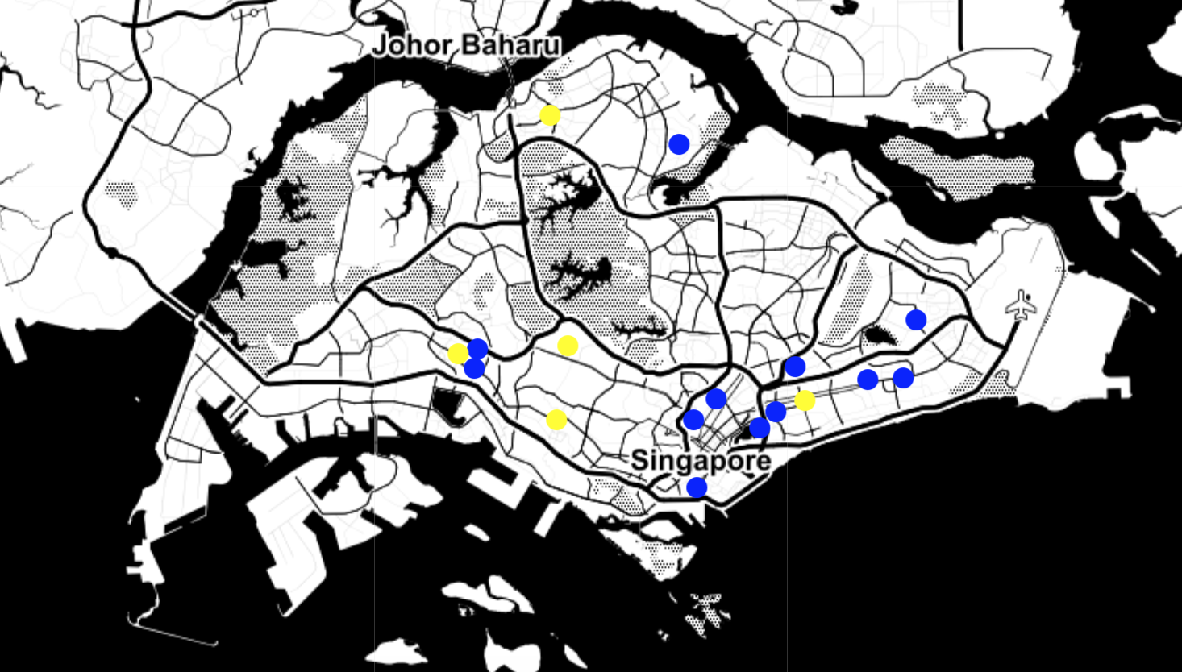
Methodology
From the geographic coordinates of our competitors’ location and the 5 locations we have shortlisted, we further plotted their locations on the Singapore map to see if there are any distinct trends and observations.
We noticed that most of our competitors' outlets are situated along main roads and clustered in the eastern parts of Singapore.
* Yellow dots = Shortlisted locations | Blue dots = Competitors’ locations

Slide 8
Results
Our competitors' locations largely have a high number of 'Food' and 'Shop & Service' venues nearby and the correlation is moderate.
Hence, for our choice of the best shortlisted location, we would be ranking the 5 shortlisted locations by their proximity to 'Food' and 'Shop & Service' venues.
Based on the ranking, our shortlisted location is Location 5 - “Causeway Point, 1 Woodlands Square"
Location | Address | Latitude | Longitude | Rating
L5 | Causeway Point, 1 Woodlands Square | 1.435984 | 103.786013 | 1.448276
L3 | KINEX, 11 Tanjong Katong Rd | 1.314850 | 103.894613 | 1.266667
L2 | IMM, 2 Jurong East Street 21 | 1.334816 | 103.746834 | 0.880460
L4 | The Star Vista, 1 Vista Exchange Green | 1.306763 | 103.788424 | 0.811494
L1 | The Grandstand, 200 Turf Club Rd | 1.337892 | 103.793338 | 0.000000

Slide 9
Discussion
The shortlisted location is reasonable as it has the most number of Food' and 'Shop & Service' venues nearby compared to the others. Furthermore, it is also not located close to any of our competitors in the northern region of Singapore.
To get a rough feel of whether our initial list of 5 shortlisted locations is comparable to our competitors' locations, we performed a simple comparison based on the average of the number of nearby venues by category.
The comparison result below shows that we have done a good job in shortlisting the initial 5 locations as the average number of nearby venues is comparable to or even exceeded that of our competitors.
Venues | Average Count (Competitors) | Average Count (Shortlisted locations)
Bus Stop | 2.5 | 2.8
Food | 10.5 | 13.8
Metro Station | 0.4 | 0.4
Shop & Service | 3.8 | 7.6

Slide 10
Conclusion
Through the use of Foursquare location API, we have a better idea of the types of common venues surrounding our competitors' locations. Using that information, we apply the same criteria to compare our 5 shortlisted locations and concluded that L5: Causeway Point, 1 Woodlands Square is the best location to set up our indoor rock climbing facility.

